Slide 1
EE 295
TechWriting-Engineering Ethics
Nov 7, 2019
Rooms E339
Tom Wrappe
EE Lecturer

Slide 2
-AI Ethics from HP
-Final Presentation Preview
-Final Paper upcoming draft
-Ethics Discussion
-2017 List from MIT
-Robotics Session (time permitting)

Slide 3
Top Ethical Issues Related to Robots
1. Unemployment. What is the problem and how to address?
2. Inequality. How do we redistribute wealth created?
3. Humanity. How do machines affect our behavior and interaction?
4. Artificial stupidity. How can we guard against mistakes?
5. Racist Robots. How do we eliminate AI bias?
6. Security. How do we keep AI safe from adversaries?
7. Evil Genies. How do we protect against unintended consequences?
8. Singularity. How do we stay in control of a complex intelligent system?
9. Robot Rights. How do we define the humane treatment of AI-driven robots?

Slide 4
Hewlett Packard Ethics of AI
HP AI Ethics

Slide 5
Hewlett Packard AI
-Moral Code of AI
-Bias
+Data Bias
+Algorithms
-Transparency
+Algorithm Transparency
+Explain the logical steps of AI
+Output may elude the designers
-Tip of the Iceberg
+Bot Interaction
+Weaponized drones
+No Jobs in the future?
-Responsibility before the power gets too high
+AI Safety is the Manhattan Project for the World Today

Slide 6
Preview of Final Presentation

Slide 7
Final Presentation
Complete Final Presentation (10% of total course grade)
-Constructed in PowerPoint slides
-3 minutes or less (will be "cut off" at 3 minutes with warning at 30 sec).
-Audience: The EE295 Class
-Topic: Why You Should Read my 10/15 Page Research Paper
This is not a presentation of the paper, but a well-developed argument convincing an audience to
read the paper, that will be delivered in the final examination timeslot to a FULL CLASS AUDIENCE (Sect 1 –last class + final test date (12.17) potentially due to class size ) (Sect 2-final test date(12.12)
All are expected to attend the full presentation times on ALL of these days and turn in a peer scoring sheet from the effort.

Slide 8
Nancy Duarte: The Secret Structure of Great Talks
Secret Structure of Great Talks Video

Slide 9
The Secret Structure of Great Talks
Overview
-What is the thesis statement?
- What are the main points of the speech?
Supporting Materials
-What types of supporting materials does the speaker provide in support of the claim (of the thesis)?
-Cite examples of this evidence
Delivery
-What does this speaker do well?
-What could the speaker have done better?

Slide 10
Final Presentation
-First Draft due no later than 11:59pm on 11.19.19
+Earlier is better if you want input
-Final Slides are due no later than 11:59pm on 12.3.19
+Discussion of the Presentation will be held in classes

Slide 11
Key Points
-Content
+Sell your paper
-Consider the audience and their interests
-What is the “way it is” and “the way it could be”?
-What will you miss if you do not read the paper
+Tell why it is worth the effort
+Take charge of the audience
+Close strongly within your 3 minutes
-Avoid
+Presenting the paper itself
+Too much hyperbole
+Too much obscure tech jargon (remember the audience!)
+Too much material (finishing early preferable to finishing late)

Slide 12
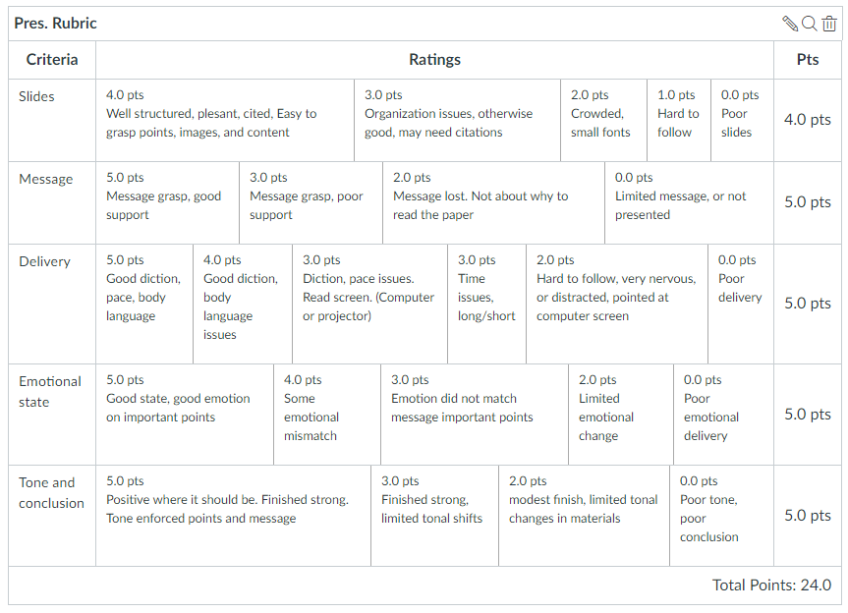
Presentation Rubric

Slide 13
Semester Major Items…..(subject to modification)
 | Mid Term | Resume | Final Paper | Final Presentation (slides )
Topic Paragraph | 9.5.19
Topic Proposed | 9.12.19 |  | 10.3.19
Topic Final | 9.19.19 |  | 10.10.19
Outline/ Abstract | 9.26.19 |  | 10.31.19
Research | 10.1.19 | 10.24.19 (Class) | 10.15.19
Draft Complete | 10.13.19 ** |  | 11.10.19** | 11.19.19
Final Submit | 10.25.19 ** | 11.14.19 | 11.26.19 | 12.3.19
Final Presentation | NA | NA | NA | 12.17.19 (Sect 1) 12.12.19 (Sect 2)

Slide 14
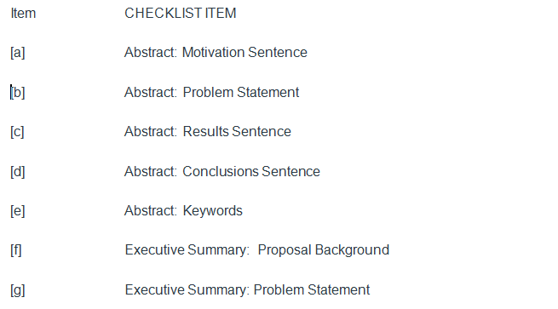
Resubmit Checklist (1)

Slide 15
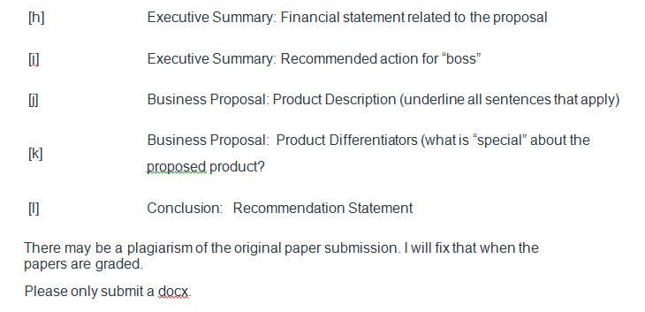
Resubmit Checklist (2)

Slide 16
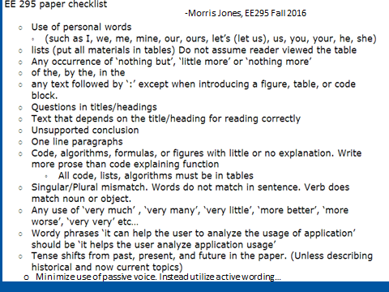
Resubmit Checklist (3)

Slide 17
Resubmit Checklist (4)
It | Description | Checklist Item (to be contained in table at end of the paper)
1 | NO PERSONAL PRONOUNS | Confirm no use of “I, we, me, mine, our, ours, let’s, us, you, your, he, she
2 | No use of “Very” | Confirm no instance of “very”
3 | Avoid Passive Voice | Confirm no passive voice
4 | All paragraphs have at least three sentences | Confirm

Slide 18
Fair Warning
In Class Writing Exercise may be starting at beginning of class coming within next two weeks (Nov 5, 7, 12 or 14)
Allowed 25 minutes to complete (hard stop)
Topic will be per recent class lectures and in class discussions (missing class will be detrimental)
Up to 10 points with 0 for “no show”
No makeups per syllabus

Slide 19
Final Paper
-Research complete
-Abstract/Outline complete

Slide 20
Final Paper: Outline/Abstract due Oct 31
Submit an outline and an abstract For your final Paper using 1-2 pages
Expand on your topic selection
-”Fine tune” your topic
-Create outline based on the complete Product Proposal or Research Paper outline
-Prepare a summary with one or two paragraphs (not bullet items, full sentence-based paragraphs) that capture the key elements of each section
Summarize your market and technology research (previously 20 sources)
-Fill out a complete checklist per instructions as a condition of grading
3.Provide a “budget” totaling 7200 +/- words (15 pages) for your Final Paper (Extended Proposal) or 5600-6000 words (10 pager Research)
4.Be ready to discuss during Nov 5 and/or Nov 7 class
5. Checklist and Peer Review (2) within one week of deadline
6.As always, 15% plagiarism or less is required from Turnitin

Slide 21
Final Paper: Outline/Abstract Feedback (1/2)
Extension of Product Proposal
a.Needed to show expanded Business Proposal (added Section 3.1, 3.2, 3.3 etc)
-Deeper dive on product description, component technology, and/or differentiating features
b. (If chosen), Show expanded Market Analysis and competitive features
New Research
Clear description of the specific research topic
Clear description of what “success” for the research area is (NOT JUST INFORMATION on WHAT THE TECHNOLOGY IS)
Single (Feasibility study) or multiple (Technology Recommendation)
How to analyze “success”
Perform the analysis
Explain the implications of the results of the analysis

Slide 22
Final Paper: Outline/Abstract Feedback (2/2)
Both Extension and Research
Motivation Sentence needs to be “why I am writing the paper” rather than “ Tech in search of a problem”
Advancing AI, Machine language driving medical, energy savings, etc. Why do medical, energy need to be improved?
Instead state the big problem and apply new tools (AI, ML, etc) to address
POPULARITY is not a motivator. Ie,” AI is getting popular, so …”
Tables and Figures must follow IEEE convention
Sequentially number figures and tables (Fig 1, 2, 3, etc)
MUST refer to figures and tables at least once from the text
Unsupported statements are not good
Demand is growing “day by day” --Must be literal truth
Need for this system has increased “day by day”
Way too much passive voice. Check this over or lose points
Indirect statements (be more concise)
Usage of land for offices→Using land for offices
Migration of data→ Transmit

Slide 23
Going Forward to Final
Resolve any structural issues on the Outline
Fill in the structure with information that matches the Outline
Solid Topic sentences for each paragraph
Make sure all supporting sentences “support” the topic sentence
Conclude
Generate Abstract, Executive Summary and Conclusion Paragraphs
Provide checklist for full content (Must turn in with Final for grading)
Review for grammar [Fill in Grammar checklist]
Relook Abstract, Executive Summary and Conclusion before turning in
Always check TII score….
Make sure you have full IEEE citations for each major support item

Slide 24
Expanding the Product Proposal for a Final Paper
Outline | Outline/ Abstract | Draft (5 pages) | Midterm paper (5 pages) | Final Paper ? 15 pages
1. Abstract | Paragraph | ½ page max | ½ page max | 1. Abstract
2. Executive Summary | paragraph | ½ to 1 page | ½ to 1 page | 2.Executive Summary
3. Product Description | 2 paragraphs or so | 1-3 pages |  | 3.0 Product Description (ex.) 3.1 System Description (ex) 3.2 Key technologies 3.3 Functional Description (ex.)
4 Mkt Research and Analysis | 1-2 paragraphs (5 sources min) | 1-3 pages | Depends on sources | 4.0 Mkt Rsch 4.1 Market 4.2 Competitors 4.3 Differentiators
5. Finance and Economics | Short paragraph | ½ to 1 page
6. Management Team | Short paragraph | ½ page
7. Risks and Assumptions | Short paragraph | ½ page
8. Conclusions and Recommendations | Short paragraph | ¼ to ½ page |  | 8. Concl/ Rec’s 8.1 Useful features 8.2 Recommended action
A. Sources | Not Applicable | ½ to 1 page | ½ to 1 page

Slide 25
Framework for Research Option #2
Area of Research
The “container” is the Analysis Process you choose:
-Compare multiple technologies by measuring their performance in a consistent “test” process (Comparative Analysis)
-Measure a single technology’s ability to perform a previously unachievable “test” (Feasibility Study)
Specific Topic
(Describe Specific Research
Research is a fluid.
It has the form of the container you choose.
Criteria for Analysis
ANALYSIS
Results and Implications
Conclusions &Recommendations

Slide 26
Framework for Research
Area of Research
Example: Deep Learning Applied to Defect Detection for Electronics
Abstract
Exec Summary/Intro
Deep Learning Basics
Deep Learning applied to defect detection
Comparison of DL To current Learning Algorithm
Results and Analysis
Conclusions and Recommendations
Specific Topic
Criteria for Analysis
ANALYSIS
Results and Implications
Conclusions Recommendations

Slide 27
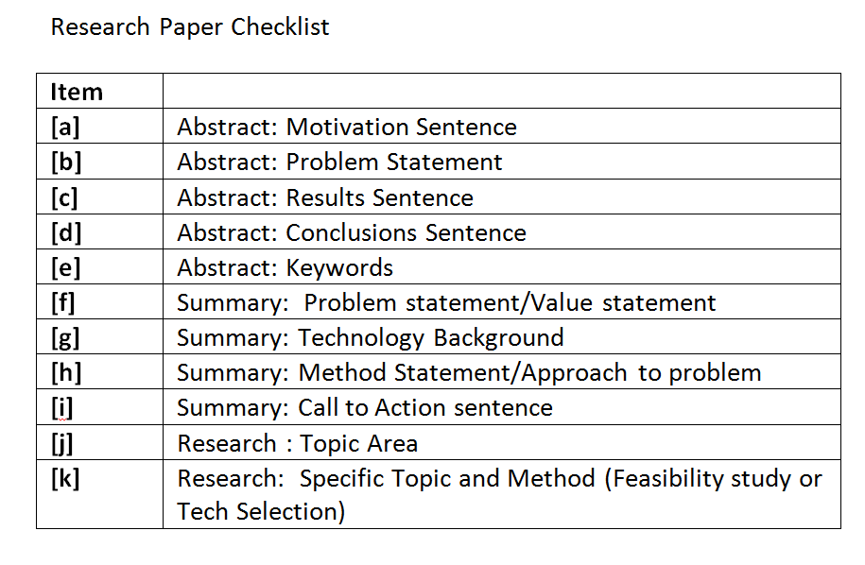
Research Paper Checklist

Slide 28
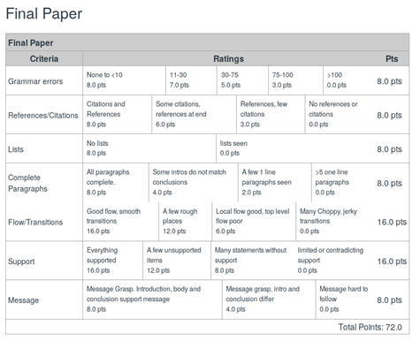

Slide 29
Resume Presentation and Discussion

Slide 30
Resume Deliverable Package
Canvas has complete description
Expectation is that there will be 4 or 5 paragraphs (Still avoid personal pronouns by using “based on analysis, the company likely expects…)
1. Introduction
Summary of the assignment and how you will approach the analysis of each Job description
2. Analysis of Job Description #1
-What is the Job?
-What is your analysis of the job description?
-What will you place in the resume to influence the particular opportunity?
3. Analysis of Job Description #2
4. Analysis of Job Description #3
5. Conclusion paragraph
-Similarities/ differences between the different Job Descriptions?
Save targeted Resume #1, 2, 3 in a file separate from the analysis

Slide 31
The OOC Work Product
Provide a summary of the analysis you are going to perform and the elements that you are going to provide for each of the three job descriptions
Answer all the questions that are laid out in the assignment in a consistent, readable way
Finish up with a short conclusion on each analysis
Attach the resumes as a followon to the analysis
High Level Outline for OOC Assignment
Summary of assignment and your approach to analysis
Analysis #1
Analysis #2
Analysis #3
Conclusion Paragraph
Resume #1, 2, 3

Slide 32
Engineering Ethics

Slide 33
Summary from Moriarty
Balance
Three kinds of ethics for three types of engineers
Premodern engineer > Virtue Ethics : Objectivity, Honesty and Caring
Modern engineer> Process Ethics (Professional)
Focal Engineer > Material Ethics guides products
Premodern Engineering
Engineering endeavor, Engineer, Engineered bound up and contextualized (Project-focused Engineering)
Think of the major cathedrals
Modern Engineering
Shift to colonization where function rules and hypermodernism arises
Consider Semiconductors and the derivative product proliferation
Focal Engineering
Balance Contextualism and Colonization
Seek the Good resulting in products that enliven, engage and resonate

Slide 34
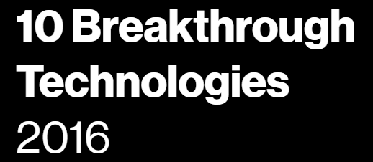
10 Emerging Technologies -MIT Review 2015
What is the Technology (4 Selected) and primary impact?
Do you foresee any moral dilemma's with this technology?
Can it be focal or contribute to a focal product?

Slide 35
The 2017 List MIT Enterprise Forum
Reversing Paralysis - Scientists are making remarkable progress at using brain implants to restore the freedom of movement that spinal cord injuries take away.
Self-Driving Trucks -Tractor-trailers without a human at the wheel will soon
barrel onto highways near you. What will this mean for the nation’s 1.7 million truck drivers?
Paying with Your Face - Face-detecting systems in China now authorize payments, provide access to facilities, and track down criminals. Will other countries follow?
Practical Quantum Computers - Advances at Google, Intel, and several research groups indicate that computers with previously unimaginable power are finally within reach.
The 360-Degree Selfie - Inexpensive cameras that make spherical images are opening a new era in photography and changing the way people share stories.
Hot Solar Cells - By converting heat to focused beams of light, a new solar device could create cheap and continuous power.
Gene Therapy 2.0 - Scientists have solved fundamental problems that were holding back cures for rare hereditary disorders. Next we’ll see if the same approach can take on cancer, heart disease, and other common illnesses.
The Cell Atlas - Biology’s next mega-project will find out what we’re really made of.
Botnets of Things - The relentless push to add connectivity to home gadgets is creating dangerous side effects that figure to get even worse.
Reinforcement Learning - By experimenting, computers are figuring out how to do things that no programmer could teach them.

Slide 36
Backup Slides

